Slide 1
Machine Learning Classes
Aqib Ahmed

Slide 2
What do we have in here for today?
Linear Regression
Forecasting and prediction using regression
Logistic Regression
K-NN classification

Slide 3
Let’s talk about linear regression - Linear Regression is a machine learning statistical method which can be used to quantify and make predictions based on relationships between numerical variables.

Slide 4
Fair assumptions to make - All variables are numeric - Predictand & predictors have linear relation

Slide 5
Points to remember
The goal of regression is to find a line that fits our data points.
The target variable of regression model is numeric
Equation to remember is y = mx + b

Slide 6
Talking of math behind linear regression
Words you will come across while discussing linear regression : slope, intercept
Y = mx + b
b is the intercept -> where line crosses the Y axis
m is the slope -> give us the steep of the line
b = change in Y / change in X

Slide 7
Let’s code Linear Regression!

Slide 8
Let’s talk about logistic regression - Logistic regression is a machine learning statistical technique used to predict probability of binary response based on one or more independent variables

Slide 9
Fair assumptions to make - All predictors are independent of each other - Data should be linearly separable - Predictand has a binary value

Slide 10
Points to remember
Logistic regression predicts the probability of an event happening.
Uses sigmoid function

Slide 11
Let’s code Logistic Regression!

Slide 12
Let’s talk about KNN Classification - K nearest neighbors is a machine learning algorithm that stores all available cases and classifies new cases based on a similarity measure

Slide 13
Fair assumptions to make - No assumptions as such ☺

Slide 14
Points to remember
KNN is a lazy algorithm which means it does not use any training data points to make any generalizations.
The target variable of KNN model can be numerical or categorical

Slide 15
Let’s code KNN Classifier!

Slide 16
Let’s talk about K Means Clustering
- K Means algorithm in an iterative algorithm that tries to partition the dataset into K predefined distinct non overlapping sub groups which are called as cluster.

Slide 17
Points to remember: - Every point belongs to only one cluster
- Clusters cannot overlap

Slide 18
Steps to calculate: - Randomly select centroids
- Calculate distances of points from centroid
- Select new centroids and repeat until centroids have
stabilized

Slide 19
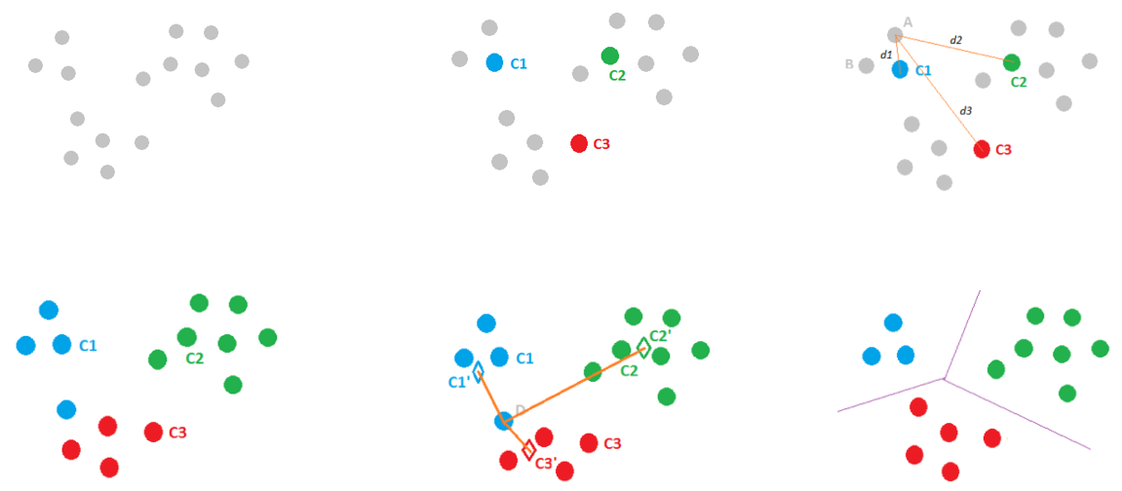

Slide 20
Let’s code K-Means!

Slide 21

Thanks!

